Slide 1

SLW Home Improvements
Members
Carson Hatem – Systems Analyst
Austin Bing-Zaremba – Business Analyst
Christian Lancaster – Co-Product Owner
Jackson Ingalls – Database/Programming Coordinator

Slide 2
Introduction
In Sprint 3, we will be covering the design of our system
This will include proposing the data model (ERD), and the process model (DFD)
We will also be including the system specifications (the logical IPO chart)
Lastly, we will be showcasing our updated product backlog and our updated PSPI

Slide 3
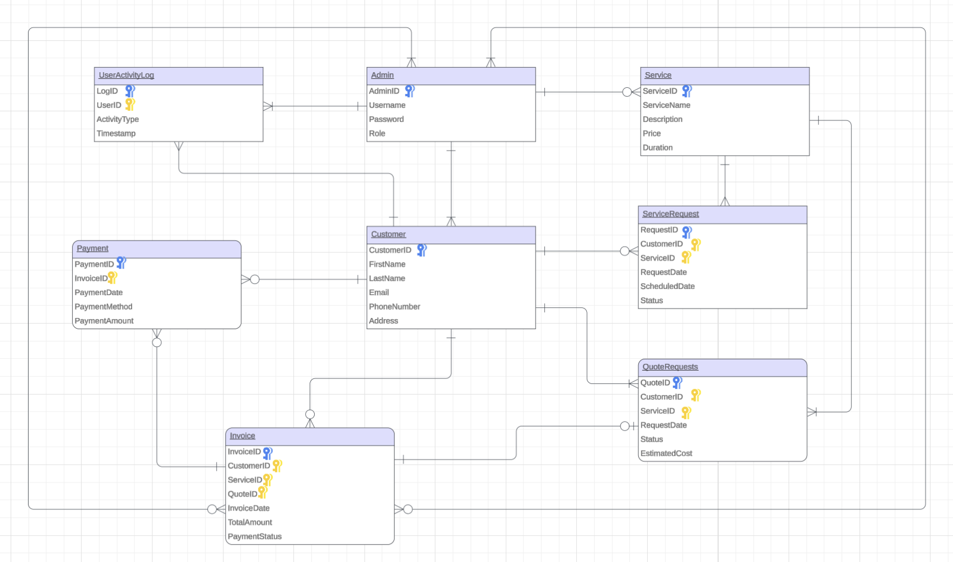

Slide 4
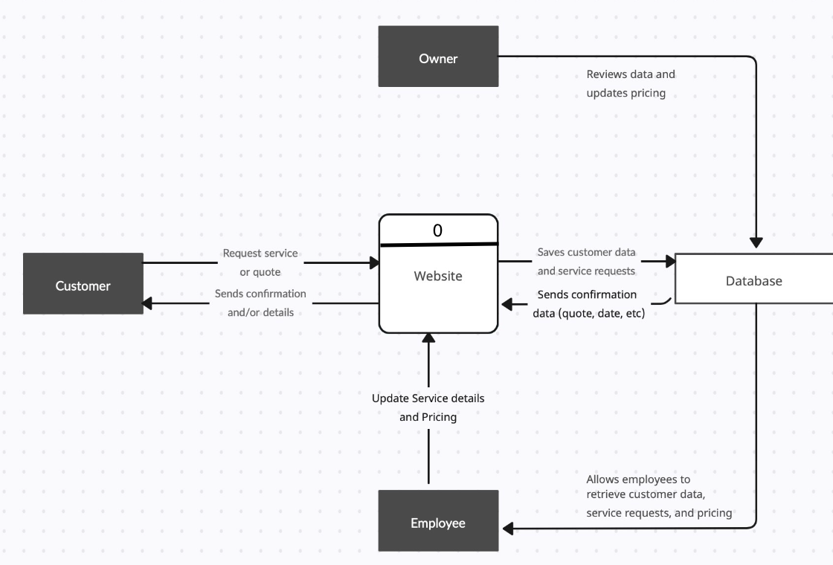
DFD Level 0

Slide 5
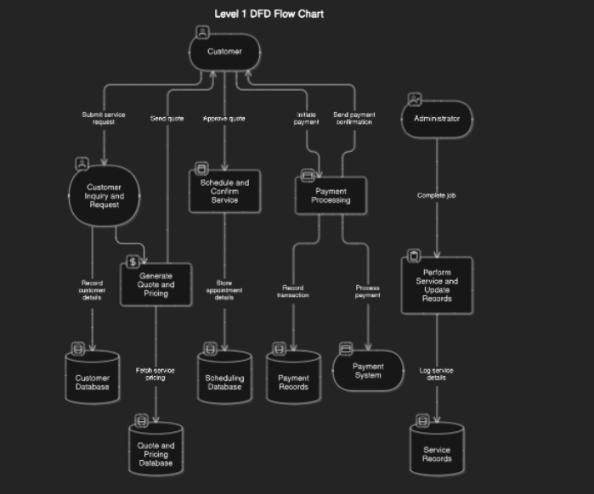
DFD Level 1

Slide 6
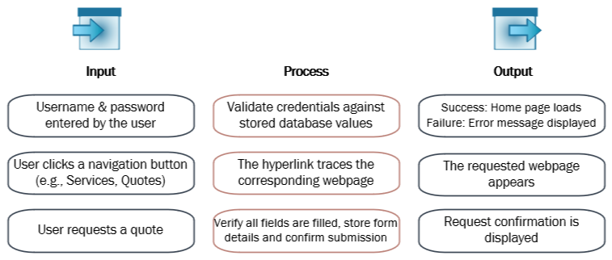
Program Plan - IPO Chart

Slide 7
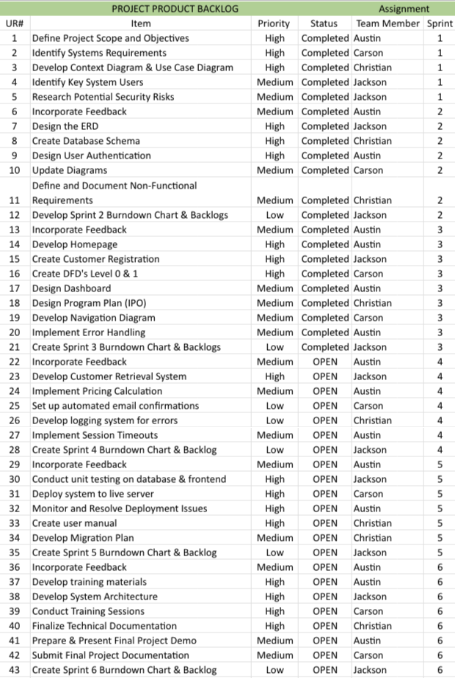
Updated Product Backlog

Slide 8
Sprint 3 Backlog
SPRINT 3 BACKLOG |  |  |  | Assignment
UR# | Item | Priority | Status | Team Member
13 | Incorporate Feedback | Medium | Completed | Austin
14 | Develop Homepage | High | Completed | Austin
15 | Create Customer Registration | High | Completed | Jackson
16 | Create DFD's Level 0 & 1 | Low | Completed | Carson
17 | Design Dashboard | Medium | Completed | Austin
18 | Design Program Plan (IPO) | Medium | Completed | Christian
19 | Develop Navigation Diagram | Medium | Completed | Carson
20 | Design Error Handling | Medium | Completed | Austin
21 | Create Burndown & Backlogs | Low | Completed | Jackson

Slide 9
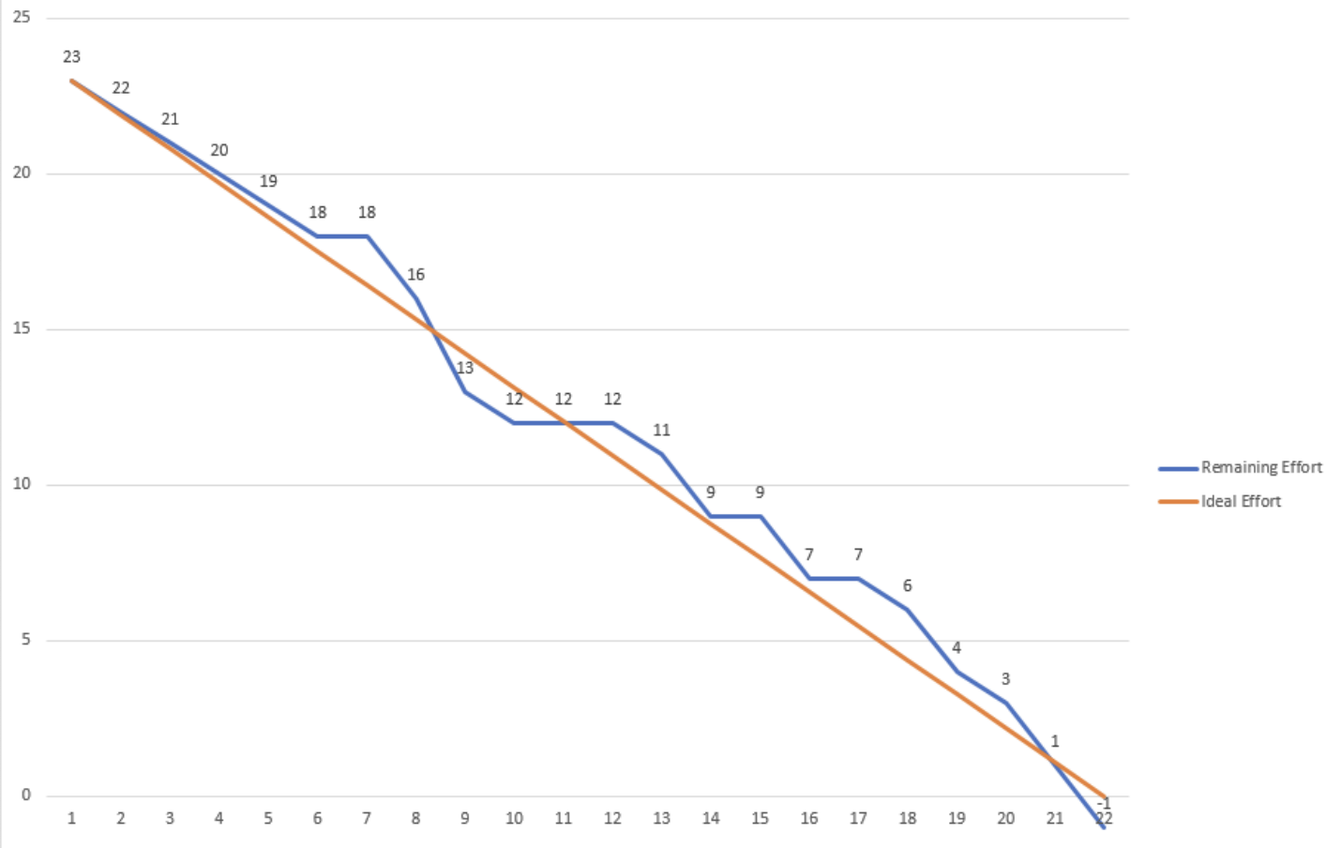
Sprint 3 Burn Down Chart

Slide 10
Project Updates
Feedback Changes – Incorporate Feedback from Sprint 2
Process and Data Modeling – Update Context Diagram, Create Level 1 Diagram & IPO
User Interface Design – Create Admin Panel, Dropdown Bar and Empty Field Pop-Up
Database Creation – Created Database Tables

Slide 11
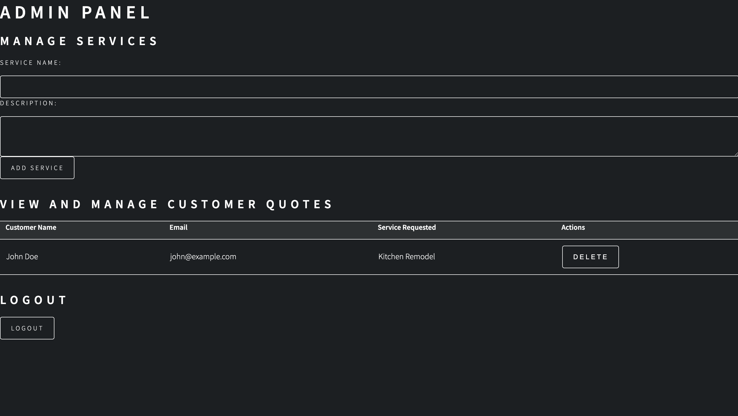
Sprint 3 PSPI
Admin Panel

Slide 12
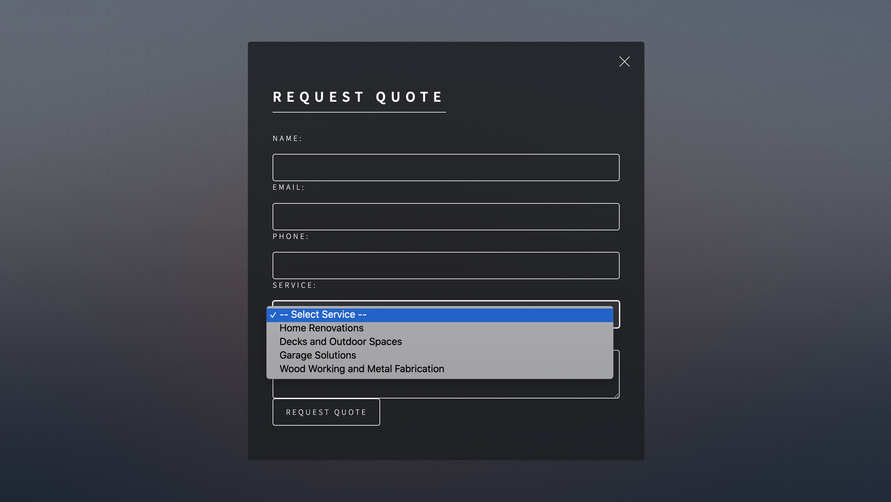
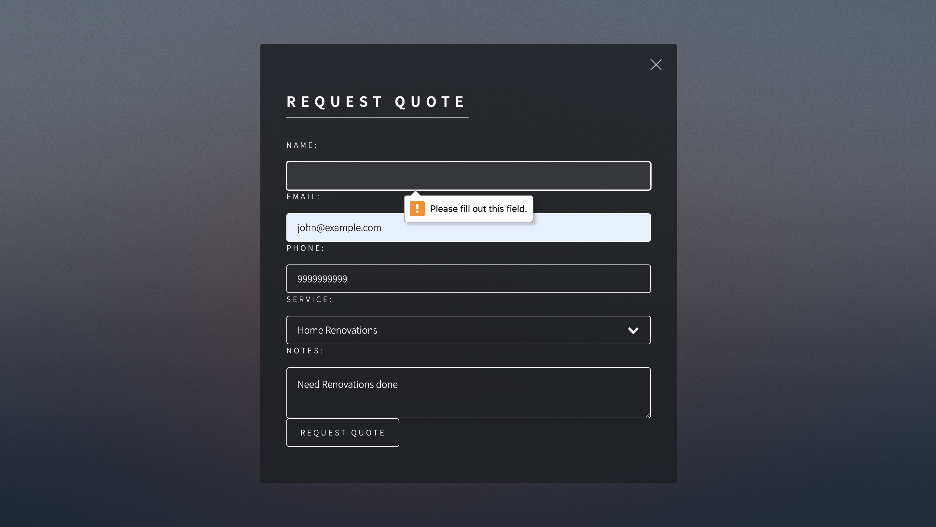
Sprint 3 PSPI
Quality of Life Changes
Dropdown Bar
Empty Field Pop-Up

Slide 13
Questions?

